Slide 1
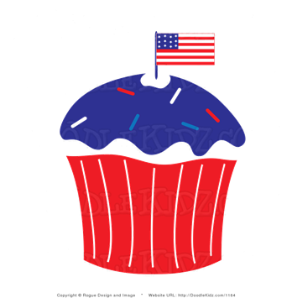
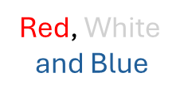
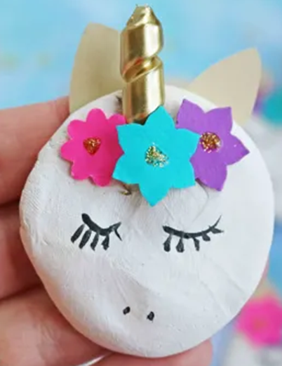
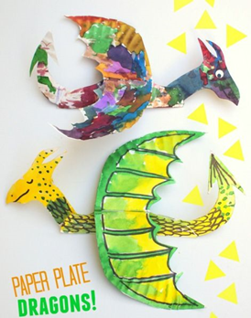
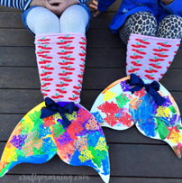
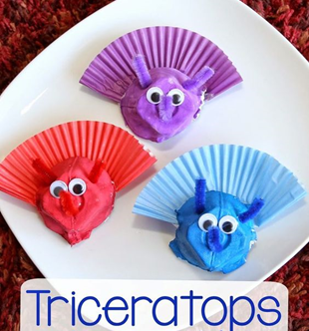
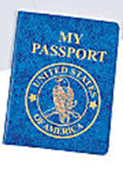
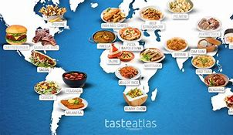
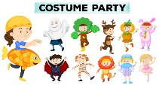
Summer 2024
Monday | Tuesday | Wednesday | Thursday | Friday
 | 6/24 | 6/25 Name Buttons | 6/26 Ice Cream Party | 6/27 | 6/8
 | 7/1 Make Flags | 7/2 | 7/3 Star Spangled Slime | 7/4 | 7/5
 | 7/8 Unicorns | 7/9 Dragons | 7/10 Mermaids | 7/11 Dino Day | 7/12
 | 7/15 | 7/16 | 7/17 | 7/18 | 7/19
 | 7/22 Methods of Travel | 7/23 | 7/24 | 7/25 | 7/26
Summer
Circus
Camp Closed
Set Up Day
Shabbat Party
Shabbat Party
Camp Closed
Mythical
Creatures
Shabbat Party
Wheels on
the Bus
Twinkle Twinkle
Little Star
Nursery
Rhymes
Old Macdonald
Itsy Bitsy Spider
Shabbat Party
Around
The
World
Shabbat Party
Foods from Other Countries
Clothing from Around the World
Dances from
Around the World

