Slide 1
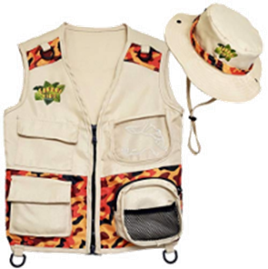
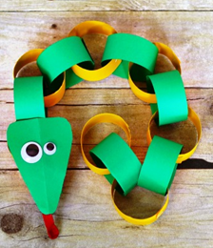
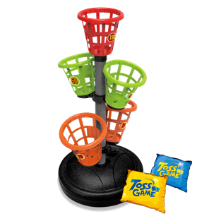
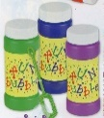
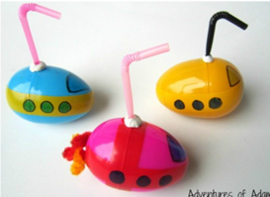
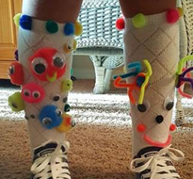
Summer 2024
Monday | Tuesday | Wednesday | Thursday | Friday
 | 7/29 | 7/30 Safari Hats & Vests | 7/31 Safari Animal | 8/1 Snakes | 8/2
 | 8/5 | 8/6 | 8/7 | 8/8 | 8/9
 | 8/12 | 8/13 | 8/14 | 8/15 Tide Pool Experience | 8/16
 | 8/19 | 8/20 | 8/21 Wacky Wednesday | 8/22 | 8/23
On Safari
Shabbat Party
Binoculars
Have
A
Ball
Fun with Bubbles
Shabbat Party
Balloon
Tennis
Bean Bag
Basketball
10AM-noonOlympics
Under
the
Sea
Seashells
Submarines
Shabbat Party
Fish
Sand Art
Wacky Week
12:30 Dismissal
Wacky Dress Up
Wacky Socks Day
21 West Main Street, Bergenfield, NJ 07621
T: 201-384-6111 1-888-GAN-AVIV F: 201-384-6133 E: info@ganaviv.com W: www.ganaviv.com

